Slide 1

Health and Socio-Economic Factors
Team DOMARA

Slide 2
The Question …
How do socio-economic and behavioral factors impact health globally?

Slide 3
How do we measure health?
Infant mortality is a common measure used for healthcare access and effectiveness.
Life expectancy is a common measure used for the overall health of a society.
Adult life expectancy (life expectancy after age 5) was used as a measure of health due to lifestyle.

Slide 4
“I think people would live a bit longer if they didn’t know how old they were. Age puts restrictions on things.”
- Karl Pilkington

Slide 5
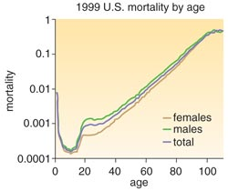
A Mortality Curve

Slide 6
Variables Considered
Form of Government – too complicated and variable within types of governments. (Removed)
Education – Literacy rate (continuous) and School Life Expectancy (discrete)
Income – Median (not readily available), per capita, and income equality (GINI index)
Medical Resources – Portion of GDP spent on medicine, physicians and hospital beds per 1K
Human Behaviors - Religion and sect, urbanization, and obesity,

Slide 7
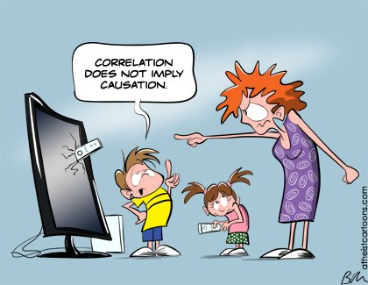
CAVEAT

Slide 8
Project Work Flow
Assignment | Primary | Reviewer/Backup
Proposal | Randall | Matt
Data Extracts | Matt | Don
Parse Data | Randall | Don
Stat. Analysis | Don | Randall
Stat. Testing | Randall | Don
Mapping results | Matt | Randall
Graphs | Don | Matt
Report Preparation | Matt | Randall
Presentation | Don | Matt
Team concerns (1 dropped class, 1 was ill and 1 had surgery) required setup with alternates and reviewers. We focused on members’ strengths.

Slide 9
Data Sources
World Health Organization – Global Health Observatory (api available)
CIA World Factbook (api available)
World Bank – IndexMundi (api available)
United Nations Development Programme (xlxs files available)
[Note: Sometimes sources used different names for the same country, such as Burma and Myanmar. When data was missing, we attempted to fill if from other sources.]

Slide 10
Why we limited our study to Countries with at least 1MM population
The highest crime rate in the world per 100,000 citizens is … THE VATICAN
Crimes are usually committed by non-citizens on non-citizens and handled by Italy.
This is due to the high number of tourists and a population of less than 1,000.
Monaco has a very high number of hospital beds per citizen, but is also highly dependent on tourism and many of the beds are available for tourists.
The 159 countries considered represent over 99% of the world’s population and two-thirds of the world’s nations.
Small countries had high variances in results and moved the averages out of proportion to their influence.

Slide 11
Initial Operations
A prescribed panda format was established with the data to be used.
A csv file of predominant religions and sects (40% cut off) was prepared based on the CIA World Factbook information.
A small sample csv file data for 24 countries was manually prepared.
Matt worked on extracting the data for all countries with population over 1M.
Randall worked on preparing graphs of the data using the sample set.
Don worked on preparing the statistics of the data using the sample set.

Slide 12
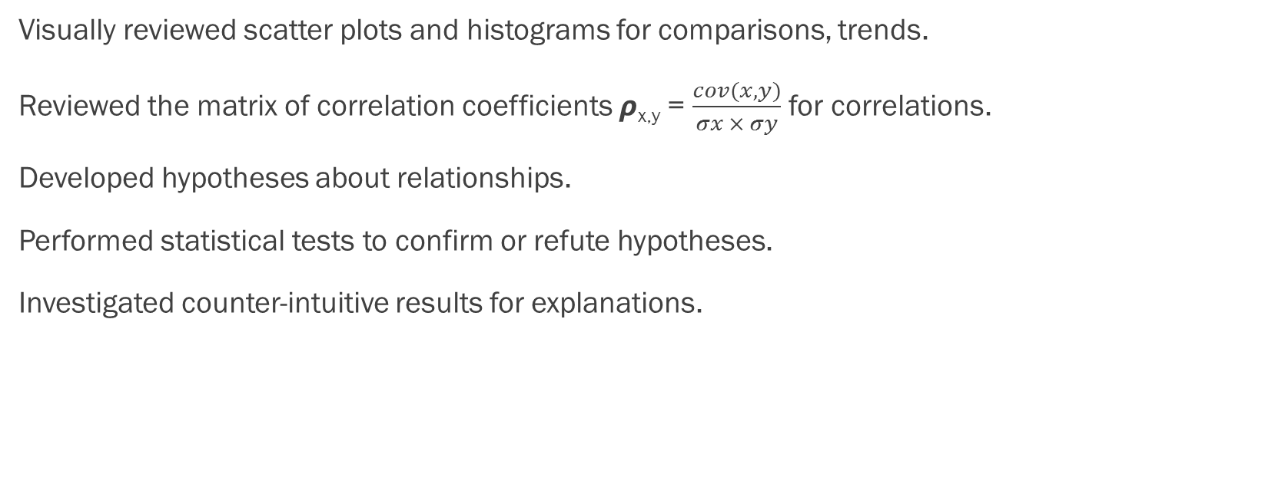
Analyses
Visually reviewed scatter plots and histograms for comparisons, trends.
Reviewed the matrix of correlation coefficients 𝞺_{x,y} = $\frac{cov(x,y)}{σx × σy}$ for correlations.
Developed hypotheses about relationships.
Performed statistical tests to confirm or refute hypotheses.
Investigated counter-intuitive results for explanations.

Slide 13
Correlation Matrix

Slide 14
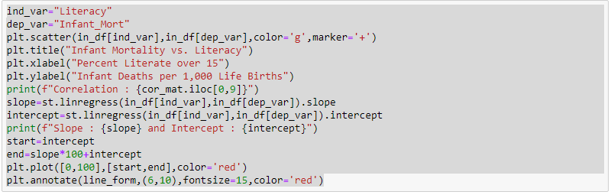
A Section of Code for a Graph, with Regression Line and Analytical Data

Slide 15
Findings

Slide 16


Slide 17
Education
Of the variables considered. education provided the most highly correlated variables to infant mortality and life expectancy.
Literacy had the greatest correlation on infant mortality.
Level of education had the greatest correction to life expectancy at age 5.

Slide 18
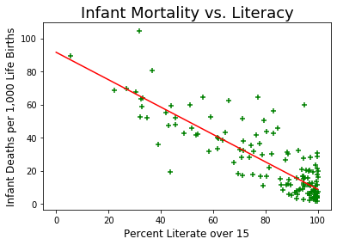
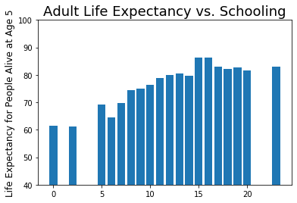

Slide 20
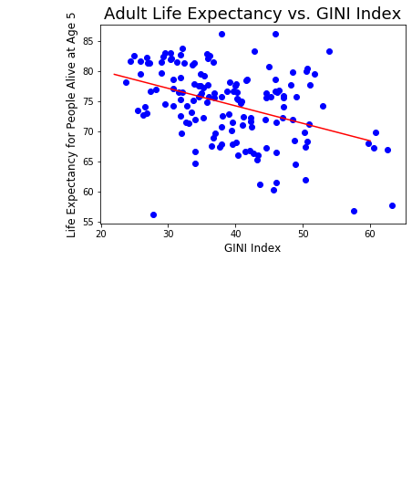
Income Equality
Although there was a slight negative correlation based on the GINI index, the influence was negligible. Higher index means higher income inequality.

Slide 21
Medical Resources

Slide 22
Urbanization

Slide 23
CAVEAT
“Jumping to conclusions usually hurts someone …
… either the one jumping or the one jumped on or both.”
--- Captain Jack Sparrow

Slide 24
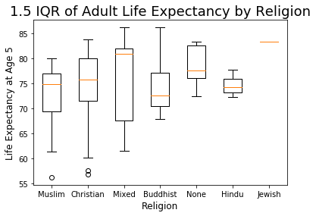
Religion
A country’s predominant religion did not have a statistically significant impact on life expectancy.

Slide 25
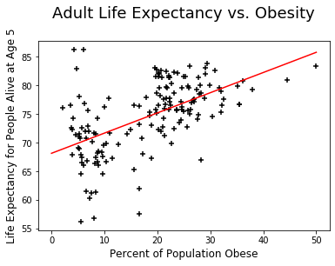
Obesity
Obesity study results indicated that as the percentage obesity in a nation increases, so does life expectancy.
This was the opposite of what we were expecting.

Slide 26
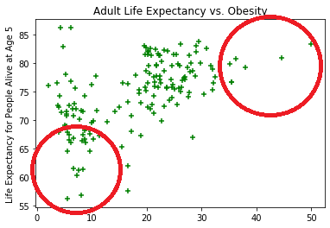
Now What?
We investigated the extremes to understand what the data was telling us.

Slide 27
Obesity
Factor | Bottom Quartile in Both Obesity and Life Expectancy | Top Quartile in Both Obesity and Life Expectancy
Count | 21 | 17
Education (School Life Exp.) | 8.7 years | 16.4 years
Per Capita GPD | $4,200 | $50,412
Doctors/1,000 | 0.15 | 2.44
HIV Infection Rate | 3.04% | 0.16%
Description | Generally Africa and SE Asia | Highly Developed Countries

Slide 28
Overall Conclusions
Poverty and lower education levels are highly correlated and contribute to higher infant mortality and shorter life expectancy at age 5.
There appears to be a minimal level of income needed to provide basic human needs and once that level is achieved, education begins to provide substantial societal health benefits.

